Slide 1
Trending Youtube Video Prediction
GROUP 10
Mentor | Animesh Tiwari
Team Members | Navaneeth
 | Sivaraj
 | Swaroop
 | Subash
 | Thirumavalavan

Slide 2


YouTube?
YouTube is used to watch music videos, comedy shows, how to guides, recipes, hacks and more. Teens also use the video-sharing service to follow their favorite vloggers (video blogger), subscribe to other YouTubers and celebrities they are interested in.
Users can search for and watch videos
Create a personal YouTube channel
Upload videos to your channel
Like/Comment/share other YouTube videos
Users can subscribe/follow other YouTube channels and users
Create playlists to organize videos and group videos together

Slide 3


YouTube Trending?
Trending shows you what’s happening on YouTube and in the world.
Trending aims to surface videos that a wide range of viewers would find interesting.
Some trends are predictable, like a new song from a popular artist or a new movie trailer. Others are surprising, like a viral video.
Are appealing to a wide range of viewers
Are not misleading or sensational
Capture the breadth of what’s happening on YouTube and in the world
Showcase a diversity of creators
Ideally, are surprising or novel

Slide 4
Problem Statement
The objective is to increase the business for new youtubers by increasing the standard of their channel and wants to increase the percentage of subscribers,views and likes.
The other objective is to suggest the advertisers to invest on which categories, region,channel and best time.

Slide 5
About Dataset
• This dataset is a daily record of the top trending YouTube videos.
• This dataset includes several months (and counting) of data on daily trending YouTube videos. Data is included for the US, GB, DE, CA, IN and FR regions (USA, Great Britain, Germany, Canada, India and France, respectively), with up to 200 listed trending videos per day.
No of Columns | 17
No of Rows | 239662
Numerical values | 4
Categorical values | 5
Missing Value | 7524
Predicting column | views

Slide 6
About Dataset
Numerical | Categorical | Objects
Views | Channel title | Video id
Dislikes | Category Id | Title
Comment count | Comments disabled | Publish Time
Likes | Ratings disabled | Tags
 | Video error or removed | Description
 | country | Trending Date

Slide 7
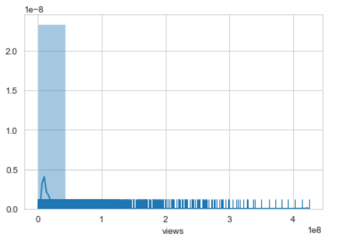
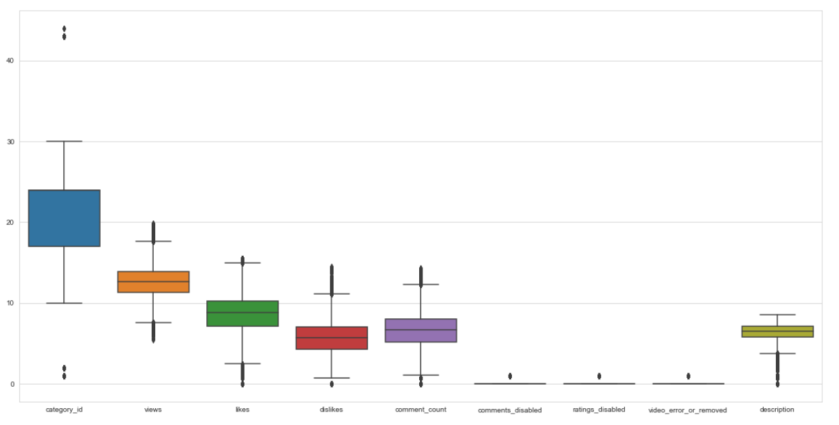
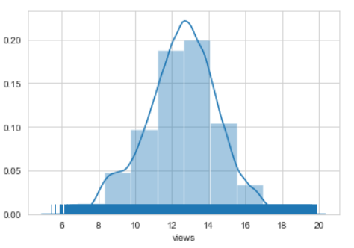
Data Preprocessing
Dropping Unnecessary Features
Null Value Treatment
Checking Imbalance Data
Label Encoding
Changed Column Format
Used Logarithmic Transformation
Checking Outliers
A) Imbalanced Data
C) Outliers
B) Balanced Data

Slide 8
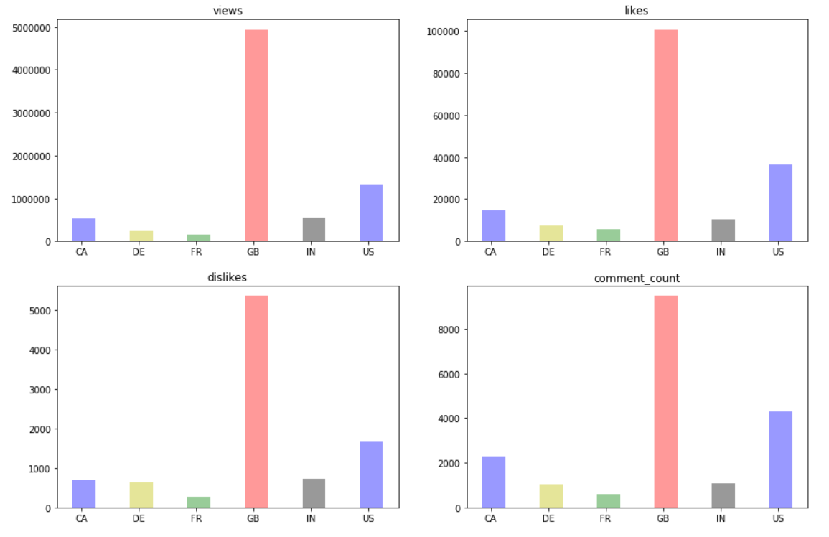
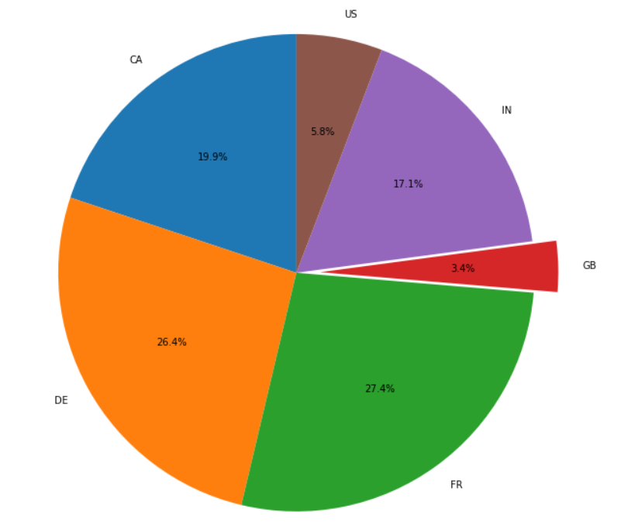
Data Analyzing
Since we have combined statistics from multiple countries, it's good to have a look on the number and ratio of videos we have in different countries. In this plot we keep only last entry for duplicated videos. That's why we can clearly observe that the country with the most long-trending video end up having lesser videos
Obviously, four of the graphs share the similar trend in numbers. One possible reason to this is due to the video's trending duration.

Slide 9
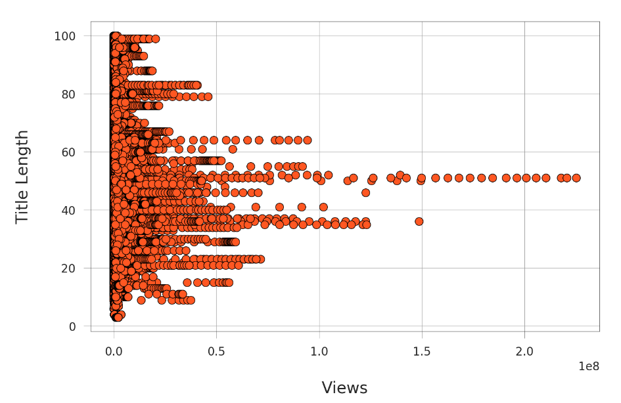
Data Analyzing
Title length is also playing an important role in trending.
Title length is no longer related with views. However, we notice an interesting thing: videos that have 100,000,000 views and more have title length between 33 and 55 characters approximately.

Slide 10
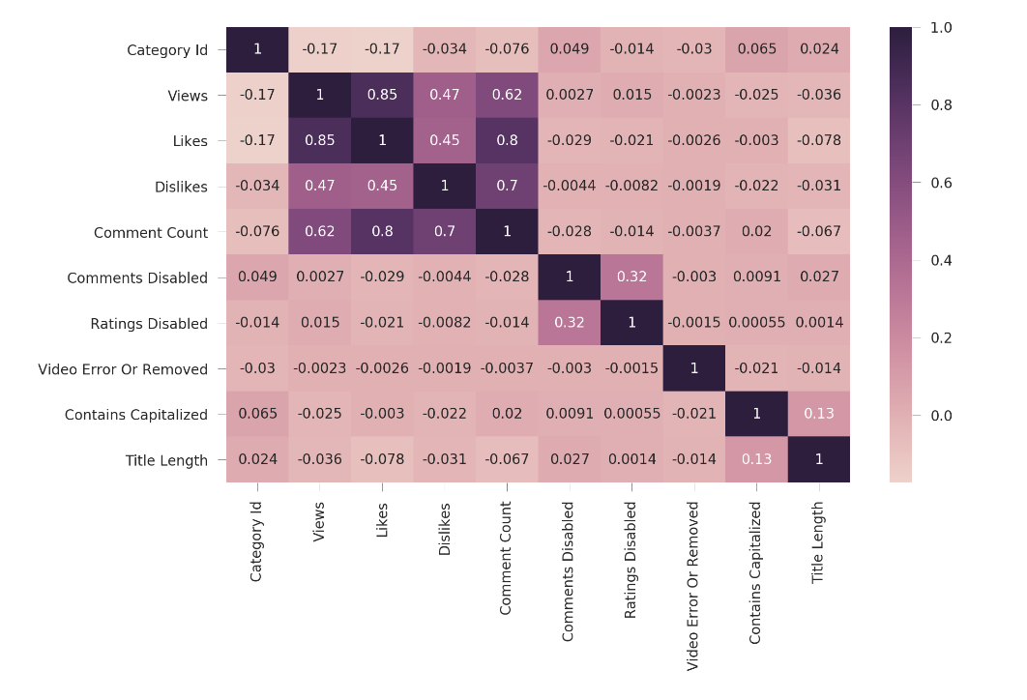
Data Analyzing
Here we got the heat map of correlation of Youtube Trending Videos between columns.
The correlation map above say that views and likes are highly positively correlated and dislikes and comment count are similarly correlated.
This can also explain why Trending video has the highest corelation with views and likes.

Slide 11
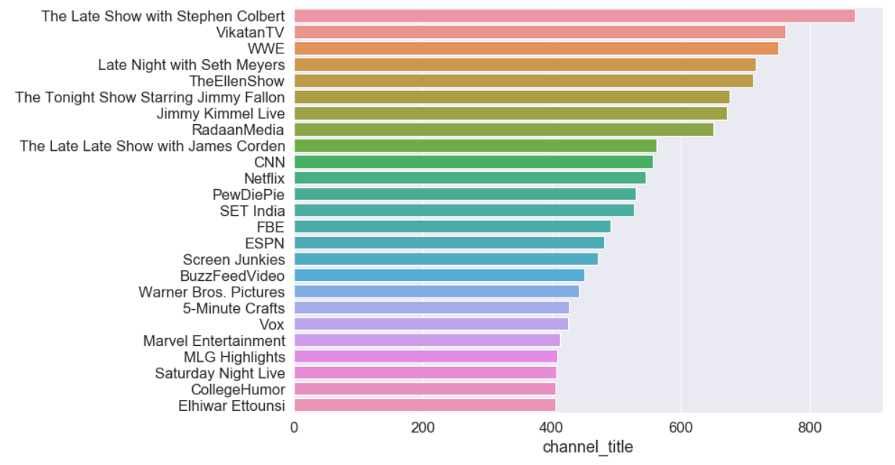
Data Analyzing
This section dedicated to top influential creators. We can see that Late show with stephen, vikatan and Late night with seth meyers are top 3 influential channel.

Slide 12
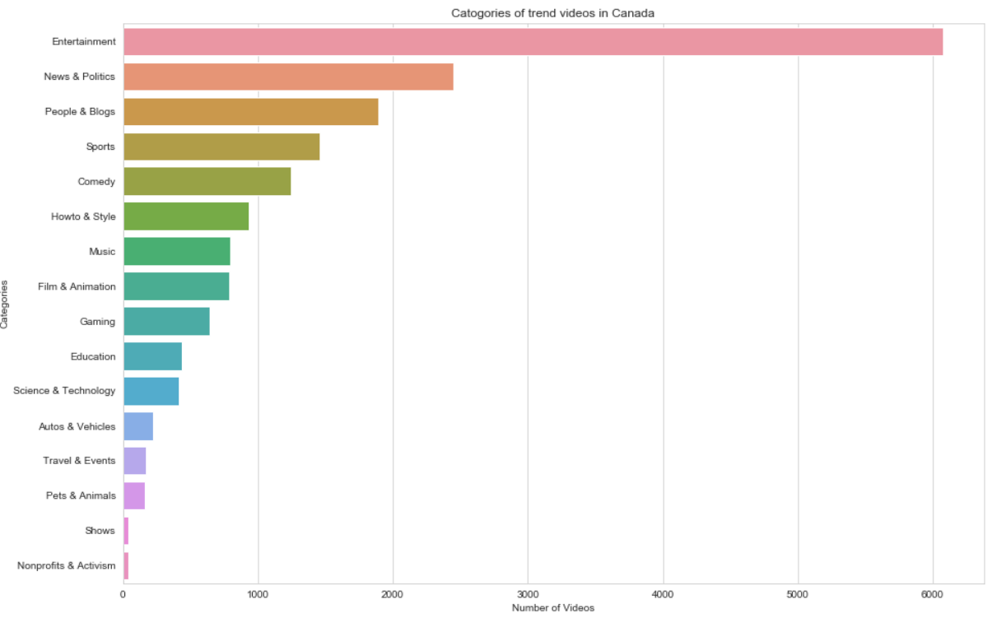
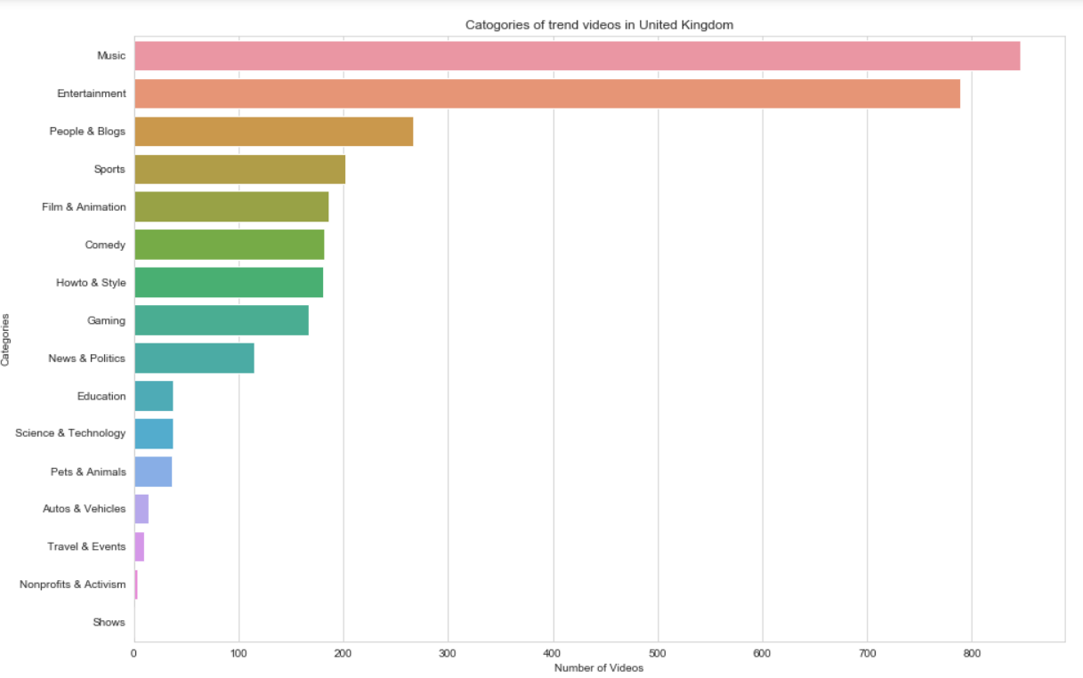
Data Analyzing
Top category of all 6 countries is Entertainment.
Music's videos ranked insignificantly in Canada, Germany and France compare to US,UK and India.
Sport's videos are more popular in Canada, Germany and France.
All top 8 categories in United Kingdom entertainment-related, this might not be a good sign.
Show's and Activism's video get the bottom rank in all most countries.

Slide 13
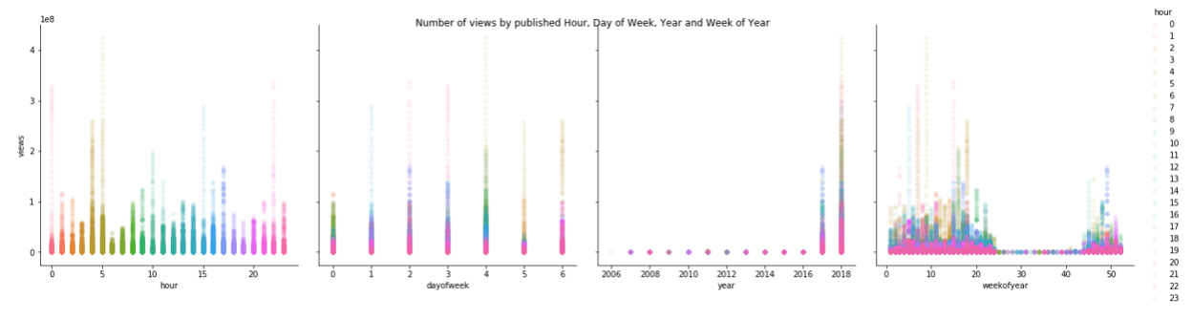
Data Analyzing
It clearly shows that in the middle weekofyear video publishing ratio is lesser compared to remaining weekofyear.
youtube videos are mostly published on 5th dayofweek and less published on 1st dayofweek .
Most number of videos are published on between late night or early morning (i.e. previous day 10pm to next day 5am)

Slide 14
Statistical Method
From the above EDA, we understood that certain features have dependency depending upon the views. So, in order to check the variations, we can use statistical methods to check the significance of the target variable with respect to the rest of the features.
Trending_year: Ttest_indResult(statistic=1262.1061816758959, pvalue=0.0)
Trending_month: Ttest_indResult(statistic=178.46126429543384, pvalue=0.0)
Category_id: Ttest_indResult(statistic=483.1902632024654, pvalue=0.0)
Views: Ttest_indResult(statistic=534.1061846558359, pvalue=0.0)
Likes: Ttest_indResult(statistic=157.16719816759854, pvalue=0.0)
Dislikes: Ttest_indResult(statistic=447.18965737474, pvalue=0.0)
Comment_Count: Ttest_indResult(statistic=776.167453636589, pvalue=0.0)
H0 is the null hypothesis and Ha is alternate hypothesis. H0- Views does not depend upon the feature. Ha- Views depends upon the feature. Significance threshold (alpha – 0.05)

Slide 15
Base Model
Linear Regression
R2: 0.850
Adj - R2 : 0.850
R2 score for train 0.8508254515951721 R2 score for test 0.8478744513423493
Mean Square Error: 0.5859476273380877
Root Mean Square Error: 0.7654721597406974

Slide 16
Overall Accuracy
Model | Accuracy Score
Linear Regression | 0.850
Random Forest | 1.000
Decision Tree | 1.000
Linear + XG Boost | 0.8988
Linear + Gradient Boost | 0.8

Slide 17
Business Outcome
We analyzed a dataset that contains information about YouTube trending videos for 205 days. The dataset was collected in 2017 and 2018.Trending videos that have 100,000,000 views and more have title length between 33 and 55 characters approximately

